Slide 1
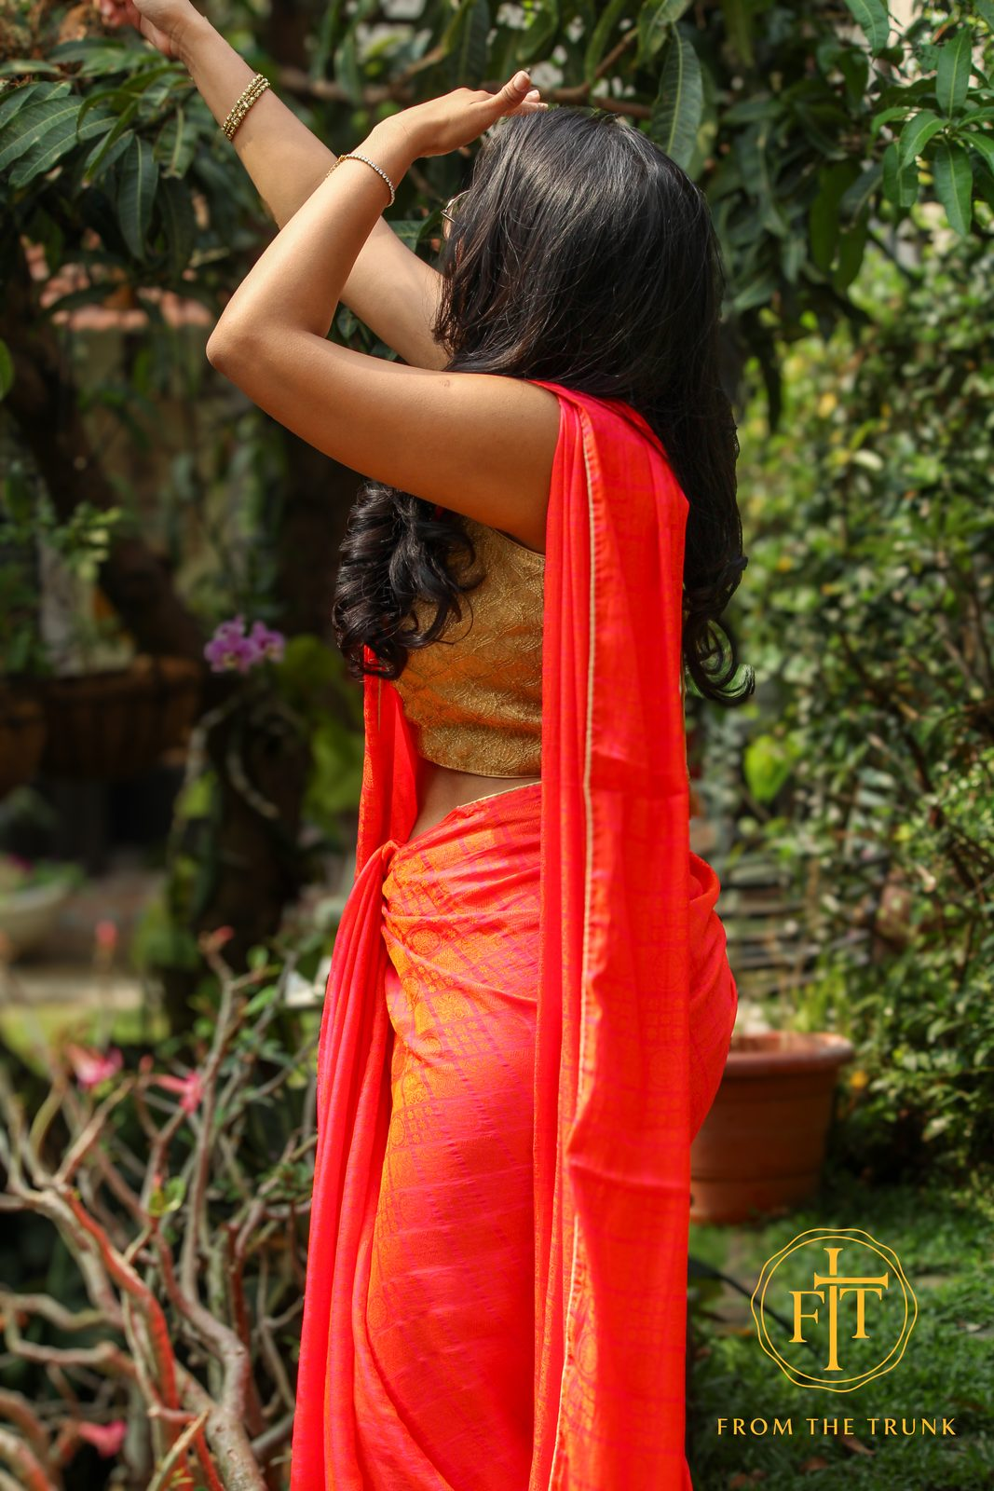
FTT
OUR STORY
Every saree deserves a second story.
Somewhere in your home, folded away in silk and memory, a saree is waiting. It carried you through a wedding, a festival, a milestone that mattered. Then it was tucked away — preserved, but unworn.
From the Trunk (FTT) was born from a simple, heartfelt belief: these sarees still have stories left to tell.

Slide 2
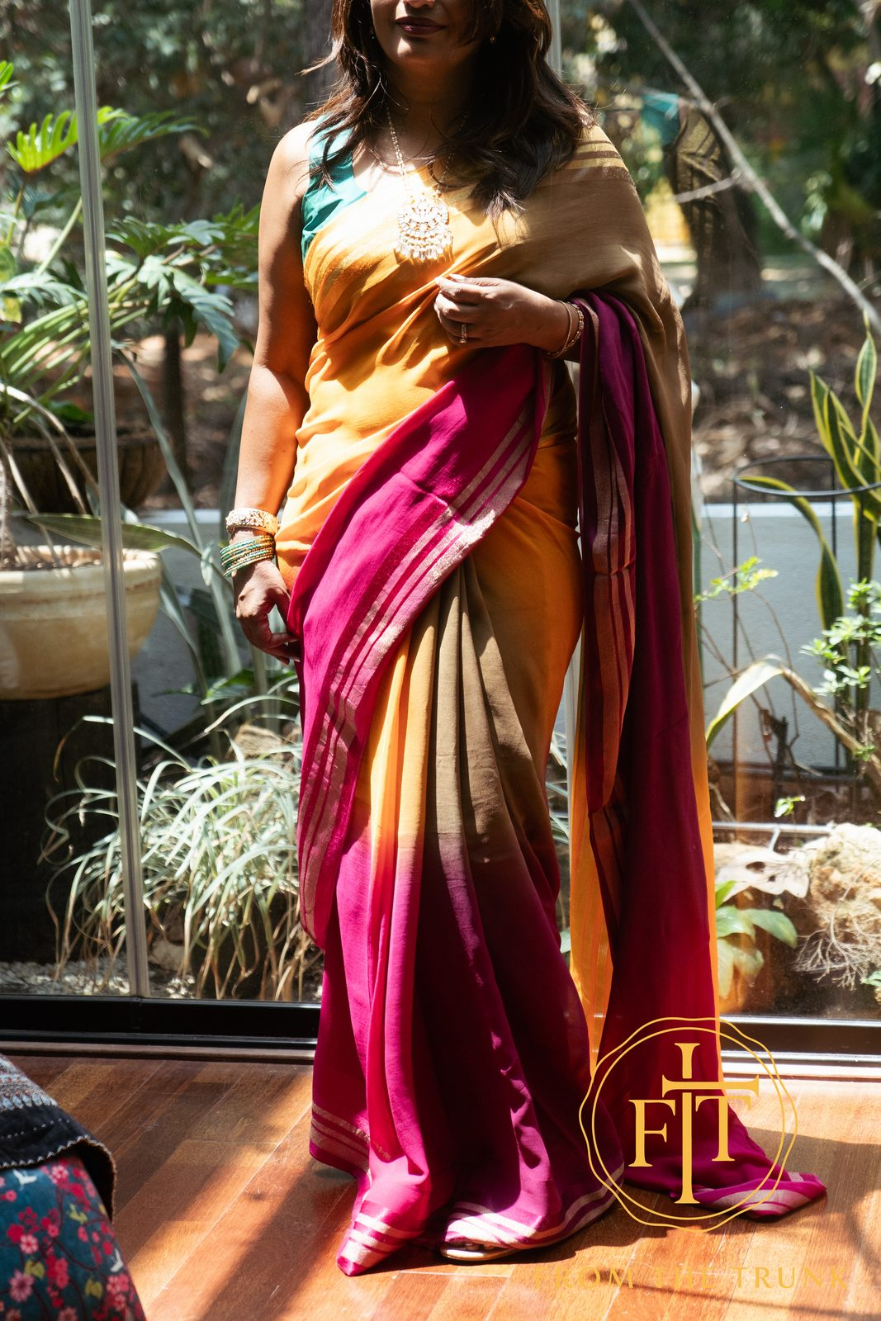
FTT
THE HEART OF IT
Never just fabric.
A saree is never just fabric. It holds the memory of a celebration, the weight of an heirloom, the colour of a moment that once meant everything. Left in the trunk, that story pauses. Worn again — by someone new — it begins all over again.
From the Trunk (FTT) is a curated home for pre-loved and vintage sarees — each one authenticated, gently restored, and documented with its own provenance. Kanjeevaram silk, soft georgette, heirloom chiffon: every piece is one of one.

Slide 3
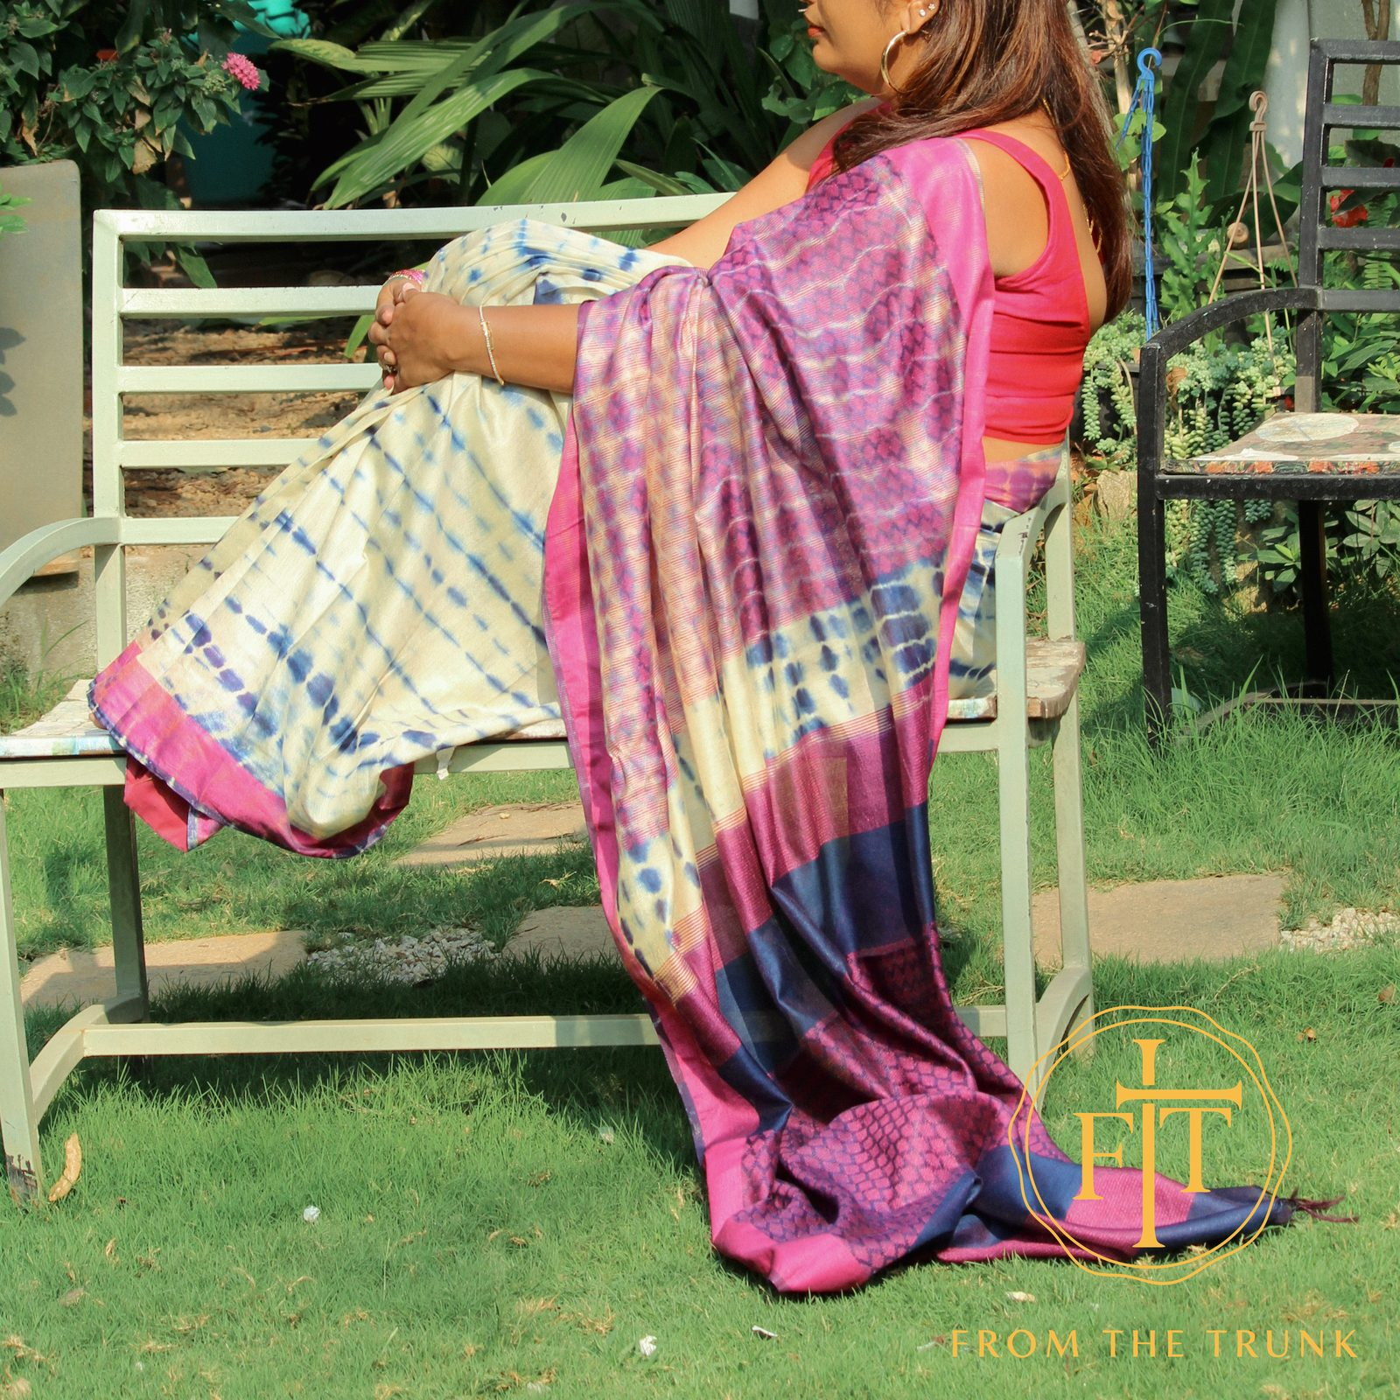
FTT
A SECOND LIFE
A bridge between past and present.
By giving your pre-loved sarees a second life, you’re not just clearing space — you’re passing on heritage, emotion, and craftsmanship. Each saree becomes a bridge between past and present, finding new meaning in someone else’s journey.

Slide 4
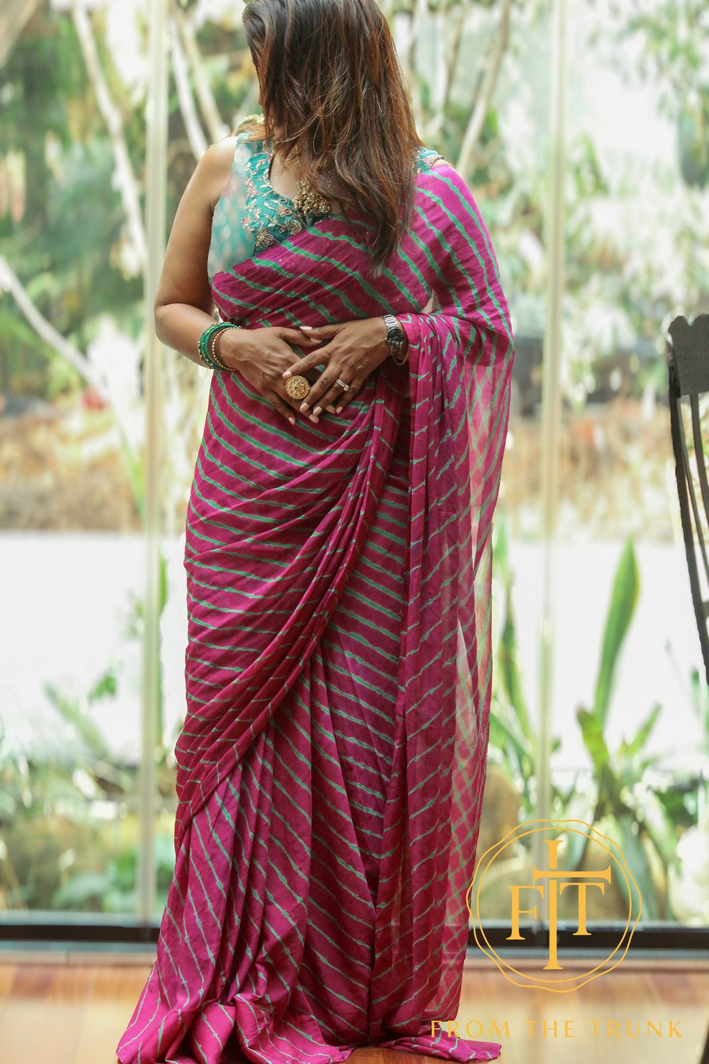
FTT
FROM THE TRUNK
Two women, one trunk.
For the woman with a saree to give
For the woman looking for one
You’ve kept it safe for years. Now let it live. Pass on the silk, the craft, the heritage — and make space for what’s next. Every saree you share finds a new occasion, a new shoulder, a new story.
Find a saree that already carries meaning — a pre-loved, restored piece that’s exquisite, timeless, and far kinder to your wallet than buying new. Wear a piece of someone’s history into a moment of your own.

Slide 5
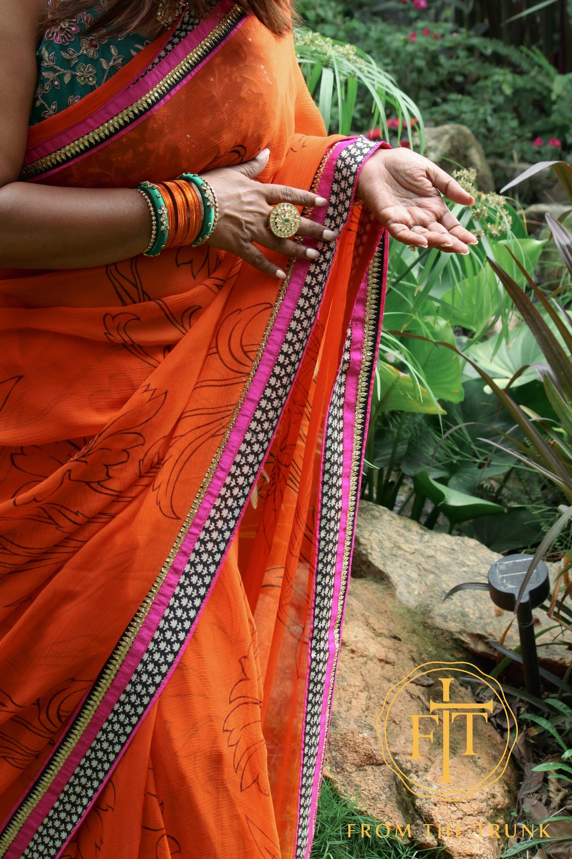
FTT
WHY IT MATTERS
Every saree worn again is one less made new.
Less waste. Less excess. A conscious, sustainable way to celebrate timeless fashion.
Buy used. Don’t buy and use.

Slide 6
FTT
THE PROMISE
At From the Trunk, we don’t just collect sarees.
We honour them.
We preserve their stories.
And we help them be loved all over again.
Open your trunk
Find your saree

